Slide 2
AI Pathfinding Algorithms in Games

Slide 3
Summary…
First, have an idea
No algorithms, just an idea
Is it good
Will it work?
Try some examples…
Try to make it FAIL (Fail fast, Fail Early)

Slide 4
Summary…
Next, try to work out the Plan
Then Work out the details
Then Implement
Then Test…

Slide 5
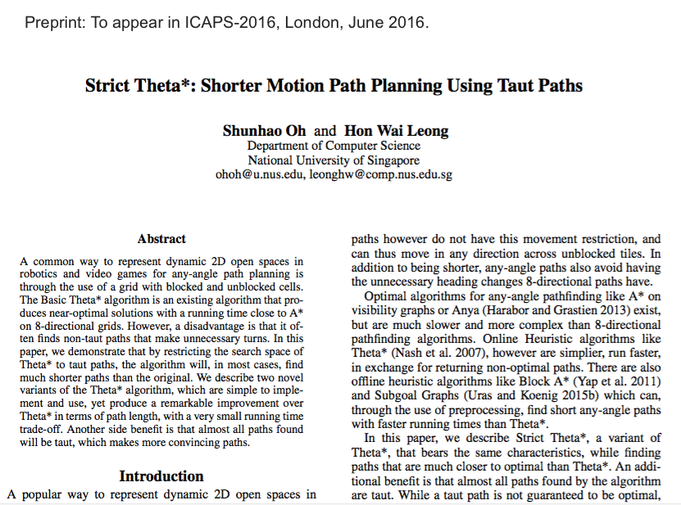


Slide 7
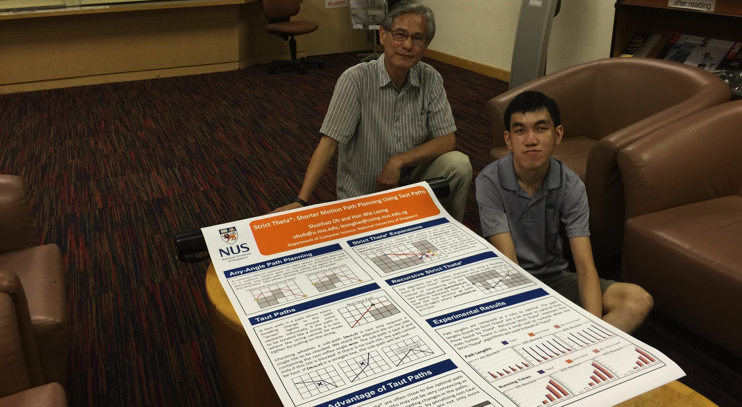
Shunhao with Poster

Slide 8


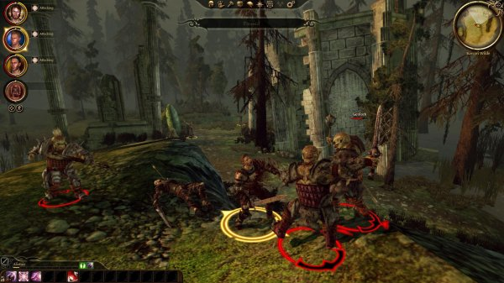
AI Pathfinding Algorithms for Games

Slide 9
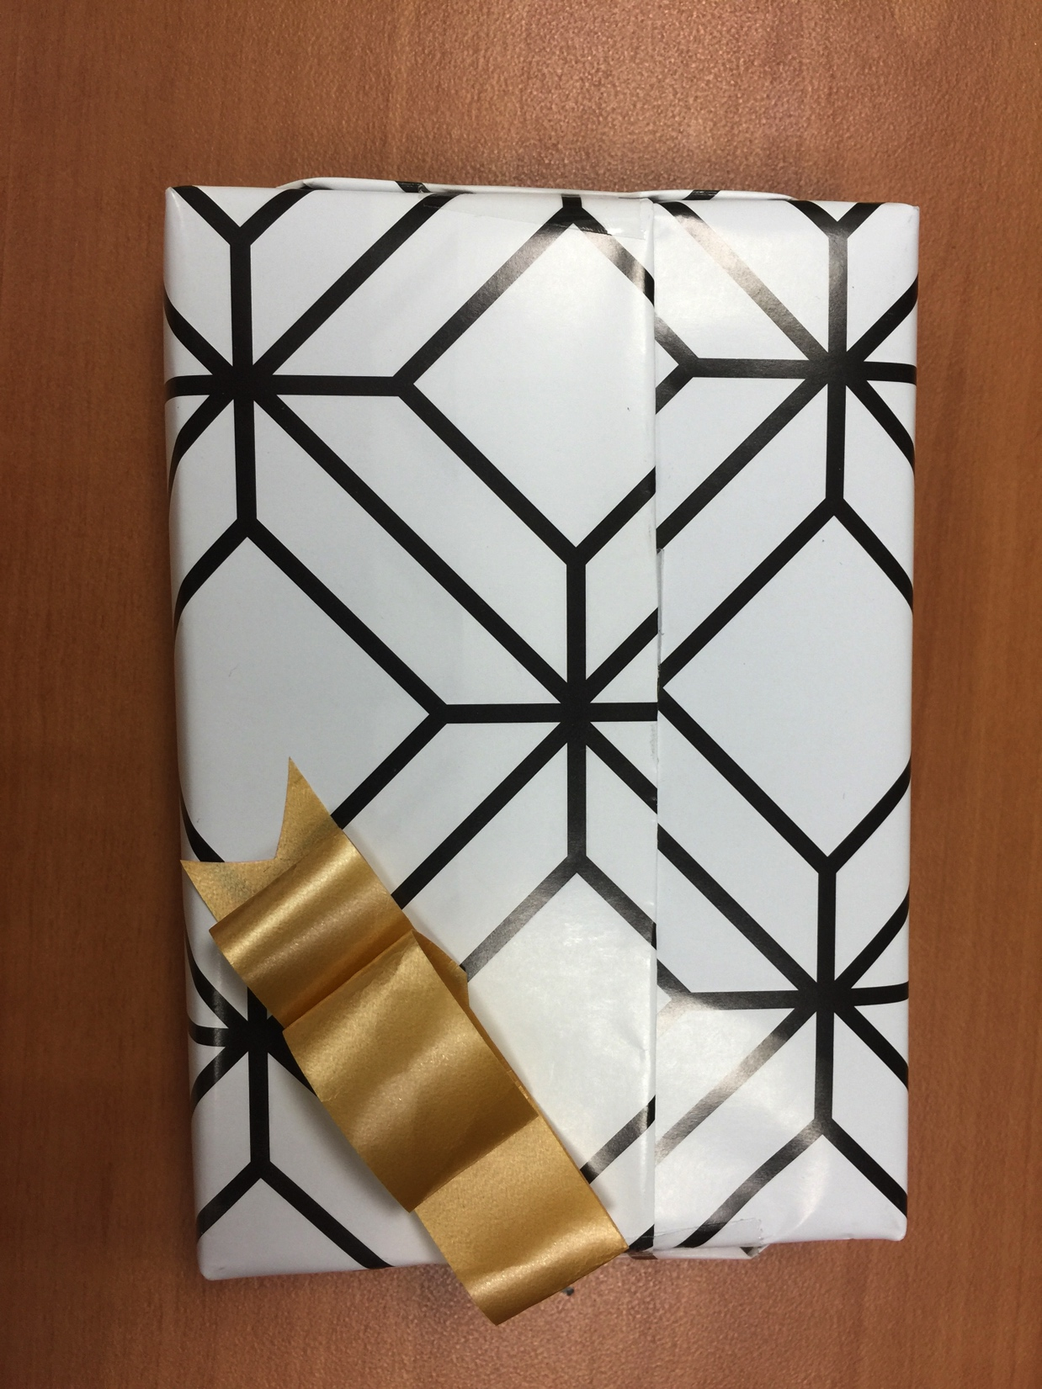
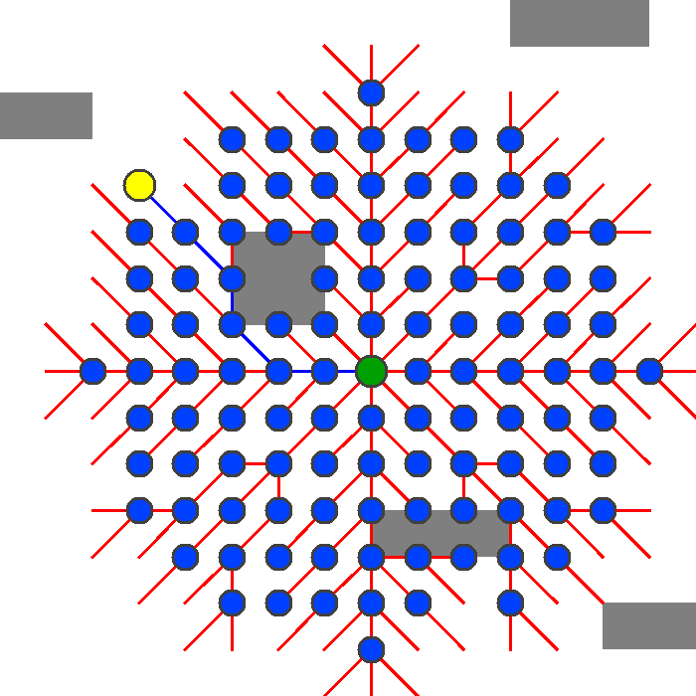
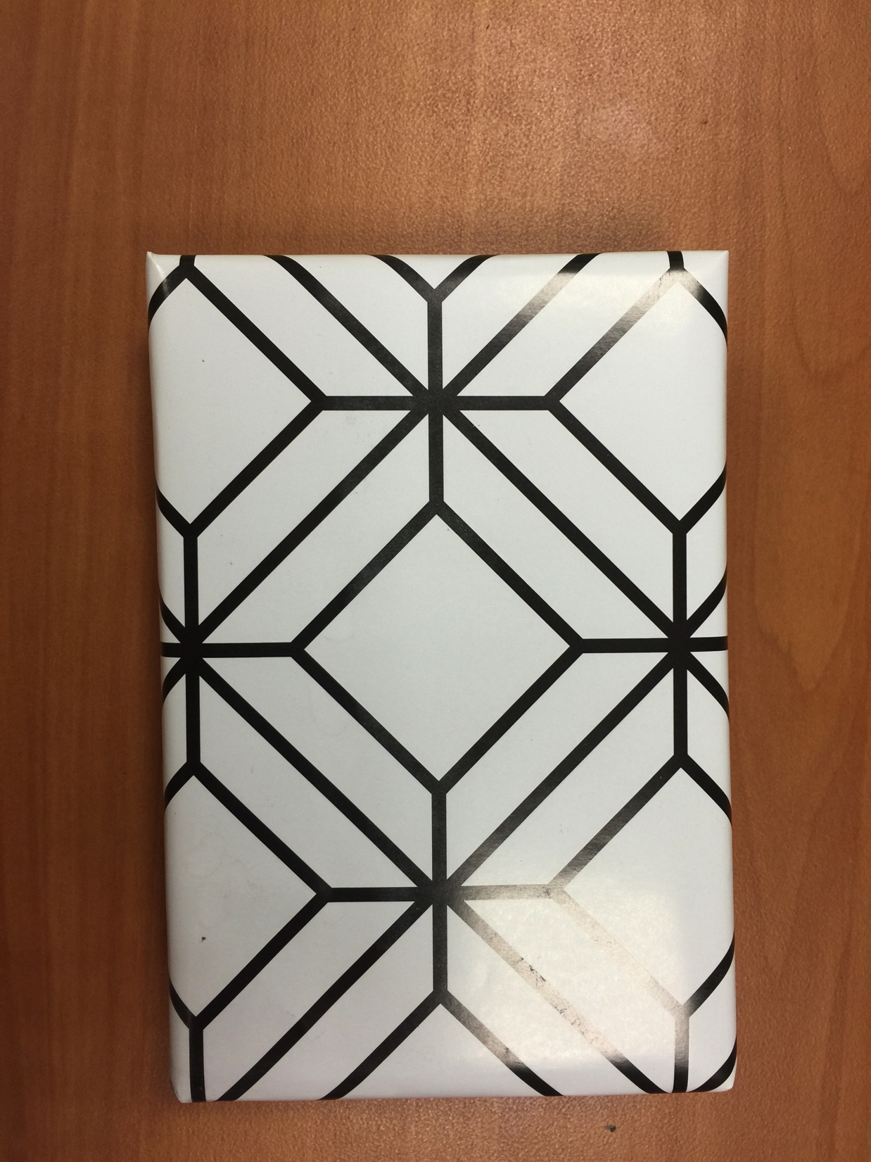
Nice, cute coincidence!
My pathfinding animation
My token of appreciation

Slide 10
Algorithms in Games:
Any-Angle Pathfinding
in Open Spaces

Slide 11


Slide 12
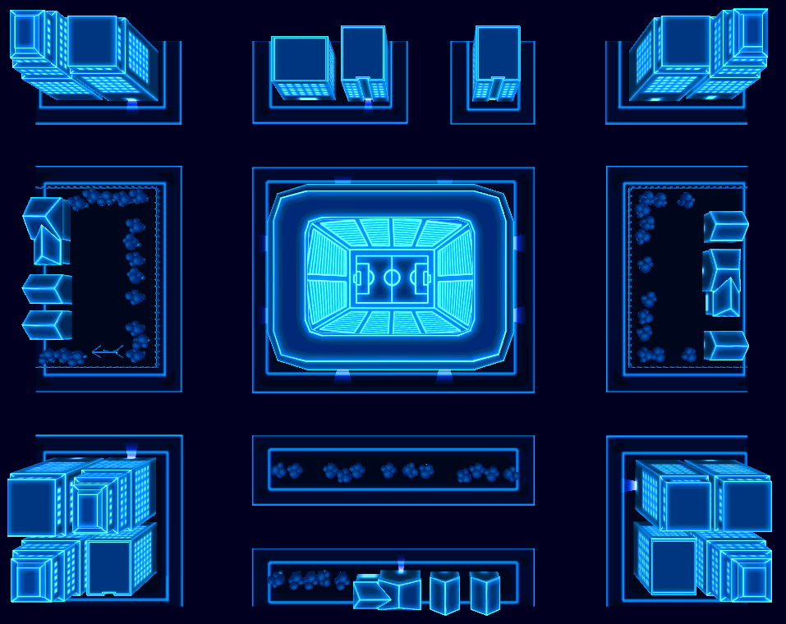

Slide 13


Slide 14


Slide 20
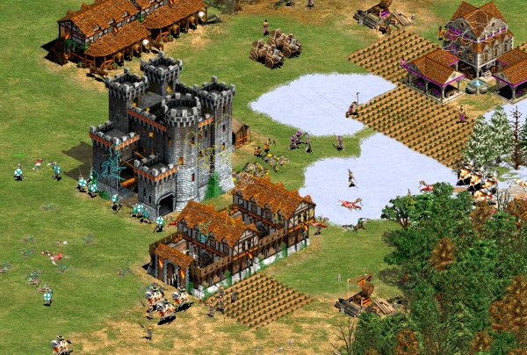

Slide 21
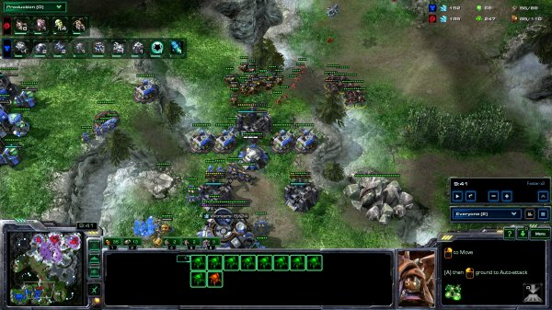

Slide 22


Slide 24
t
s

Slide 25
1.4
2.6
1.7
2.0
t
1.2
1.4
s
0.6
1.3
0.8
1.2
1.3

Slide 26
1.4
2.6
1.7
2.0
t
1.2
1.4
s
0.6
1.3
0.8
Dijkstra’s
Algorithm
1.2
1.3

Slide 27
1.4
2.6
1.7
2.0
t
1.2
1.4
s
0.6
1.3
0.8
1.2
1.3

Slide 29
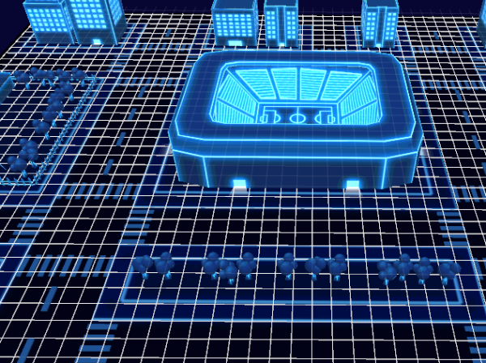
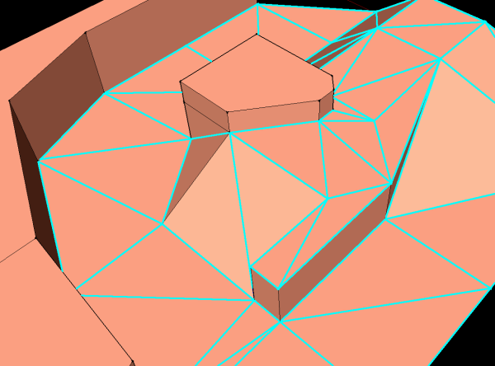
Grids
Navigation Mesh

Slide 30
Grids
Navigation Mesh

Slide 32
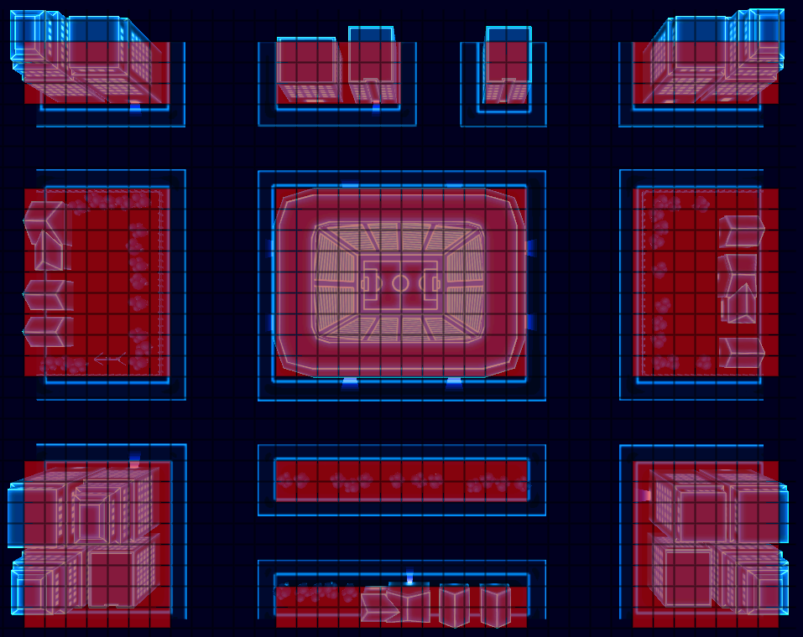

Slide 33
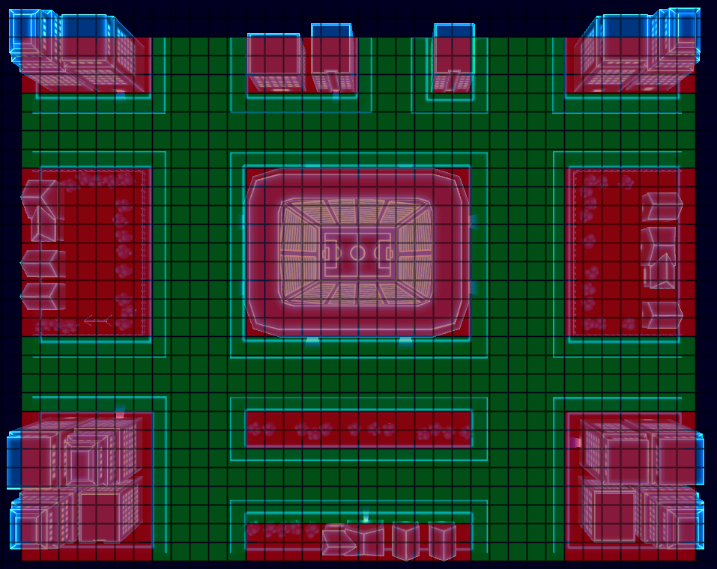

Slide 35
How do you do
pathfinding in games?

Slide 36
How do you do
pathfinding in games?
Some Obvious Answers:
Dijkstra Algorithm on the Grid
Dijkstra with A* (or just called A*)

Slide 37
How do you do
pathfinding in games?
Some Obvious Answers:
Dijkstra Algorithm on the Grid
Dijkstra with A* (or just called A*)
Consider 8-directional paths
Any-Angle Paths?

Slide 38
Advancements in
Any-Angle path planning
2005: Field D* (Ferguson, Stentz)
2007: Theta* (Daniel, Nash, Koenig)
2009: Accelerated A* (Sislak, Volf, Pechoucek)
2011: Block A* (Yap, Burch, Holte, Schaeffer)
2013: Anya (Daniel, Alban)

Slide 39
Advancements in
Any-Angle path planning
2005: Field D* (Ferguson, Stentz)
2007: Theta* (Daniel, Nash, Koenig)
2009: Accelerated A* (Sislak, Volf, Pechoucek)
2011: Block A* (Yap, Burch, Holte, Schaeffer)
2013: Anya (Daniel, Alban)
2016: Strict Theta* (Oh Shunhao & Leong H W)

Slide 42
Shunhao with Poster

Slide 43
How do you do
pathfinding in games?
Basic answer:
A* Algorithm

Slide 44
A* Algorithm
with
8-directional paths
and a quick refresher of A*,
(or dijkstra’s algorithm, if you don’t know what A* is)

Slide 45
What is A*?

Slide 46
What is A*?
Dijkstra + heuristic
= A* Algorithm

Slide 47
8-directional movement
s
t

Slide 48
8-directional movement
s
t

Slide 49
Which vertex to explore next?
s
t

Slide 50
Dijkstra’s Algorithm
s
t

Slide 51
Dijkstra’s Algorithm
1
1.4
1.4
s
1
1
1.4
1.4
1
t

Slide 52
Dijkstra’s Algorithm
s
t

Slide 53
Dijkstra’s Algorithm
s
t

Slide 54
Dijkstra’s Algorithm
s
t

Slide 55
Dijkstra’s Algorithm
s
t

Slide 56
Dijkstra’s Algorithm
s
t

Slide 57
A* Algorithm
s
t

Slide 58
A* Algorithm
1
1.4
1.4
s
1
1
1.4
1.4
1
t

Slide 59
A* Algorithm
1
1.4
1.4
s
1
1
1.4
1.4
1
t

Slide 60
A* Algorithm
1
1.4
1.4
s
1
1
1.4
1.4
1
2.8
t

Slide 61
A* Algorithm
1
1.4
1.4
s
1
1
1.4
4.2
1
2.8
t

Slide 62
A* Algorithm
1
1.4
1.4
s
1
1
1.4
4.2
1
3.6
t

Slide 63
A* Algorithm
1
1.4
1.4
s
1
1
1.4
4.2
4.6
3.6
t

Slide 64
A* Algorithm
6
7.1
5.9
s
6
4.6
5.9
4.2
4.6
t

Slide 65
A* Algorithm
s
t

Slide 66
A* Algorithm
s
t

Slide 67
Dijkstra vs A*
Demo
Dijkstra_Demo
Astar_Demo

Slide 68
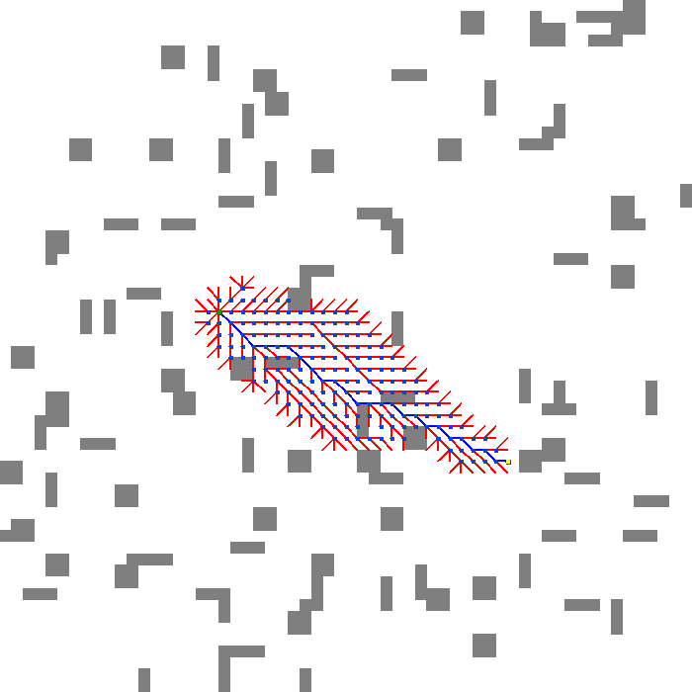
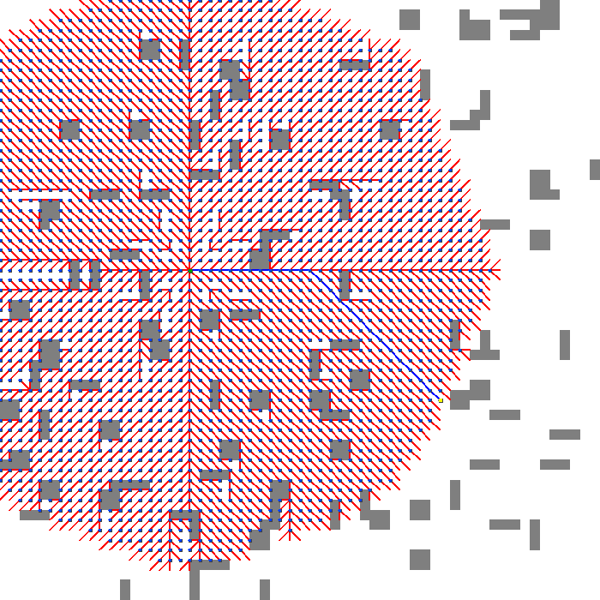
A*
Search Tree
Dijkstra
Search Tree

Slide 69
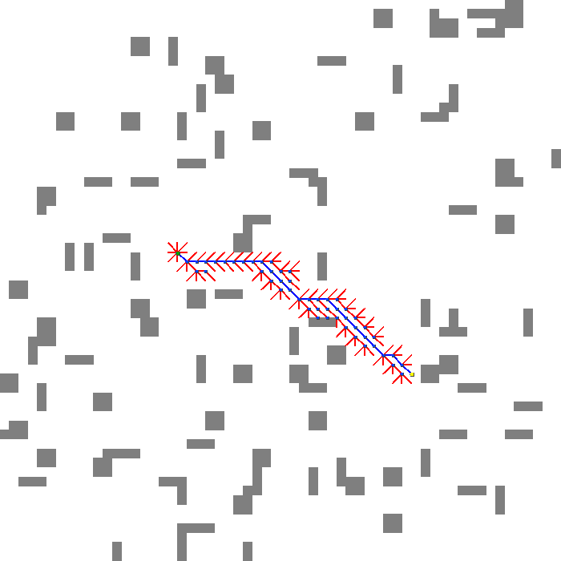
A* with Octile Heuristic

Slide 70
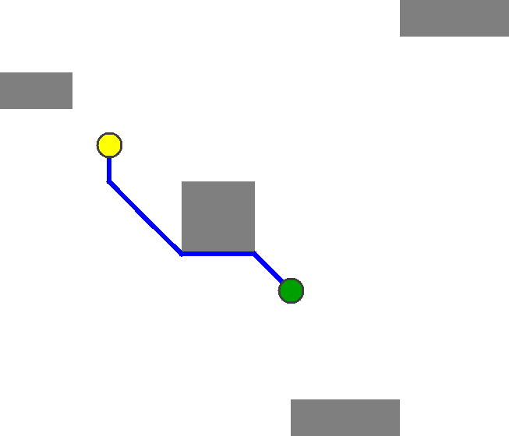
It works,
but isn’t exactly ideal.

Slide 71
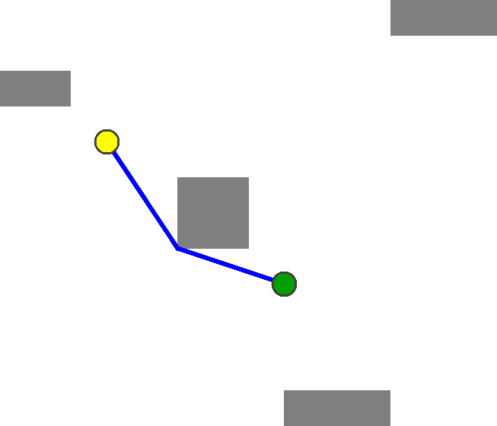
We’d prefer
Something like this.

Slide 72
Any-Angle Pathfinding
Algorithms
Visibility
Graphs
Theta*

Slide 73
Any-Angle Pathfinding
Algorithms
Visibility
Graphs
Theta*

Slide 74
Any-Angle Pathfinding
Algorithms
Visibility
Graphs
Theta*

Slide 75
Theta* Algorithm
Similar to A*,
but with one little change

Slide 76
Theta* Algorithm
t
s

Slide 77
Theta* Algorithm
t
s

Slide 78
Theta* Algorithm
t
s

Slide 79
Theta* Algorithm
t
s

Slide 80
Theta* Algorithm
t
s

Slide 81
Theta* Algorithm
t
PATH 2
PATH 1
s

Slide 82
Theta* Algorithm
t
PATH 2
PATH 1
s

Slide 83
Theta* Algorithm
t
s

Slide 84
Theta* Algorithm
t
s

Slide 85
Theta* Algorithm
t
s

Slide 86
Theta* Algorithm
t
s

Slide 87
Theta* Algorithm
Demo
ThetaStar_Demo
ThetaStar_Big

Slide 88
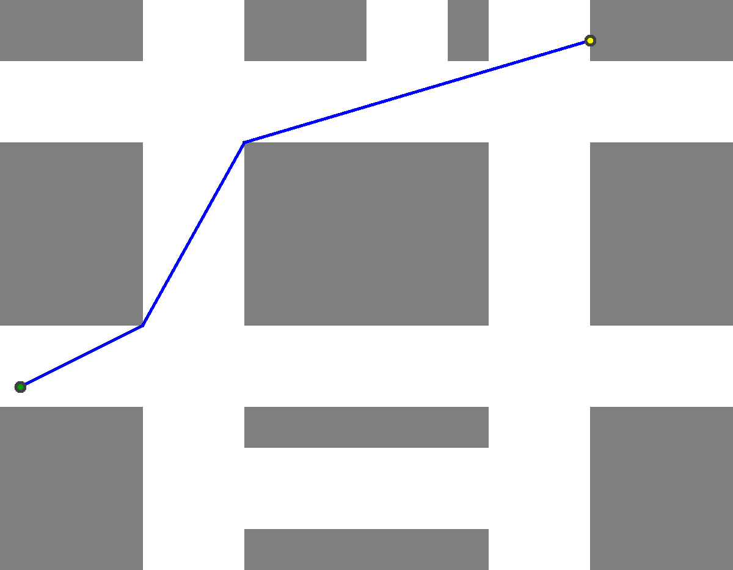

Slide 91
How do I check
Line-of-Sight?

Slide 92
Example: No Line-of-Sight!
u
v

Slide 93
Bresenham’s
Line-Drawing
Algorithm

Slide 94

Bresenham’s
Line-Drawing
Algorithm

Slide 95
Bressenham’s line-drawing algorithm
Check grid squares in this order:
u
v

Slide 96
Bressenham’s line-drawing algorithm
Check grid squares in this order:
u
v

Slide 97
Bressenham’s line-drawing algorithm
Check grid squares in this order:
u
v

Slide 98
Bressenham’s line-drawing algorithm
Check grid squares in this order:
u
v

Slide 99
Bressenham’s line-drawing algorithm
Check grid squares in this order:
u
v

Slide 100
Bressenham’s line-drawing algorithm
Check grid squares in this order:
u
v

Slide 101
There is Line of Sight if and only if none
of these squares are blocked.
u
v

Slide 102
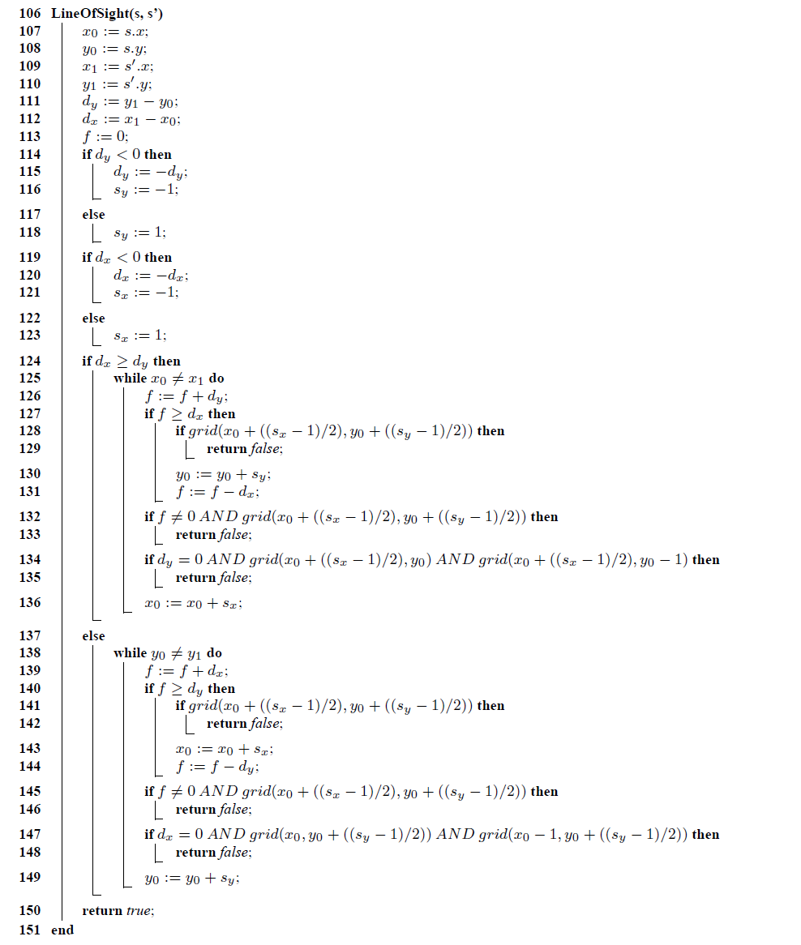

Slide 103
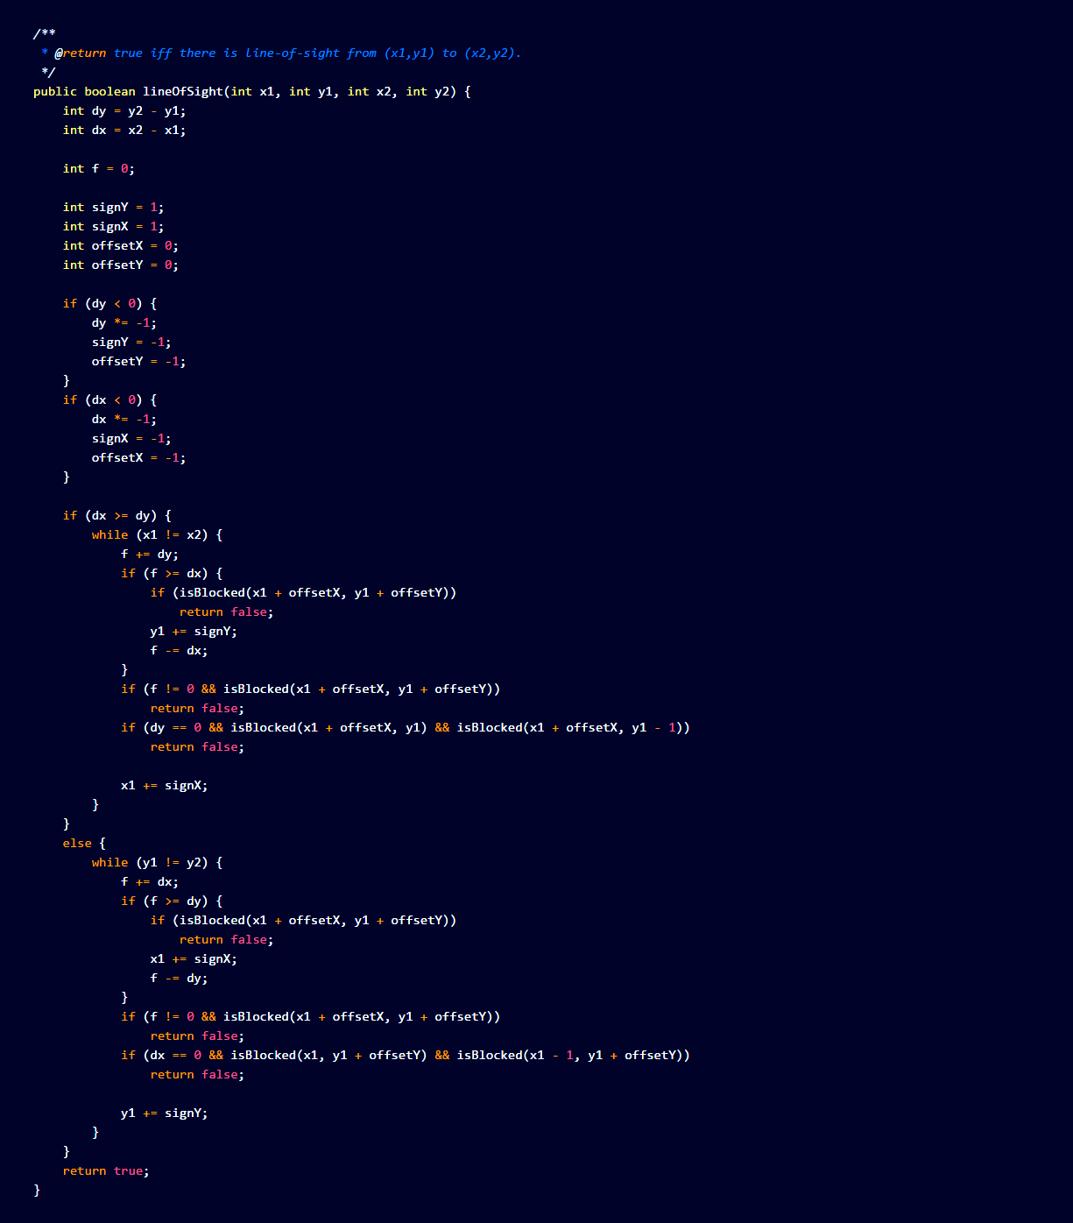

Slide 104
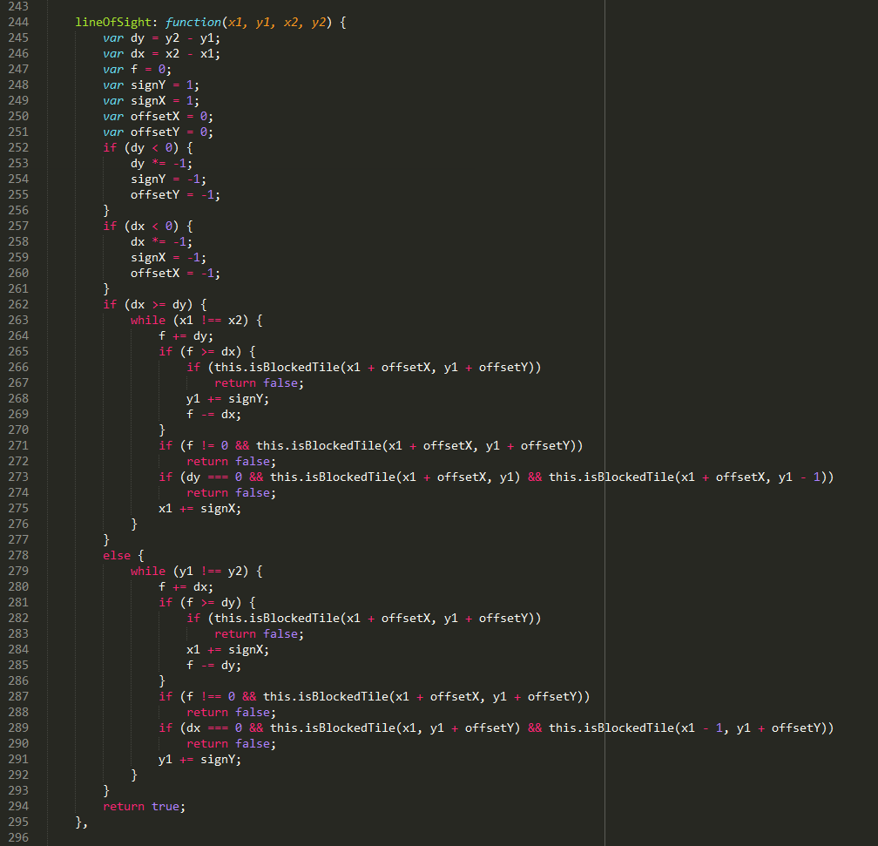

Slide 105
Theta*
is not Optimal
Demo
ThetaStar_Hard

Slide 106
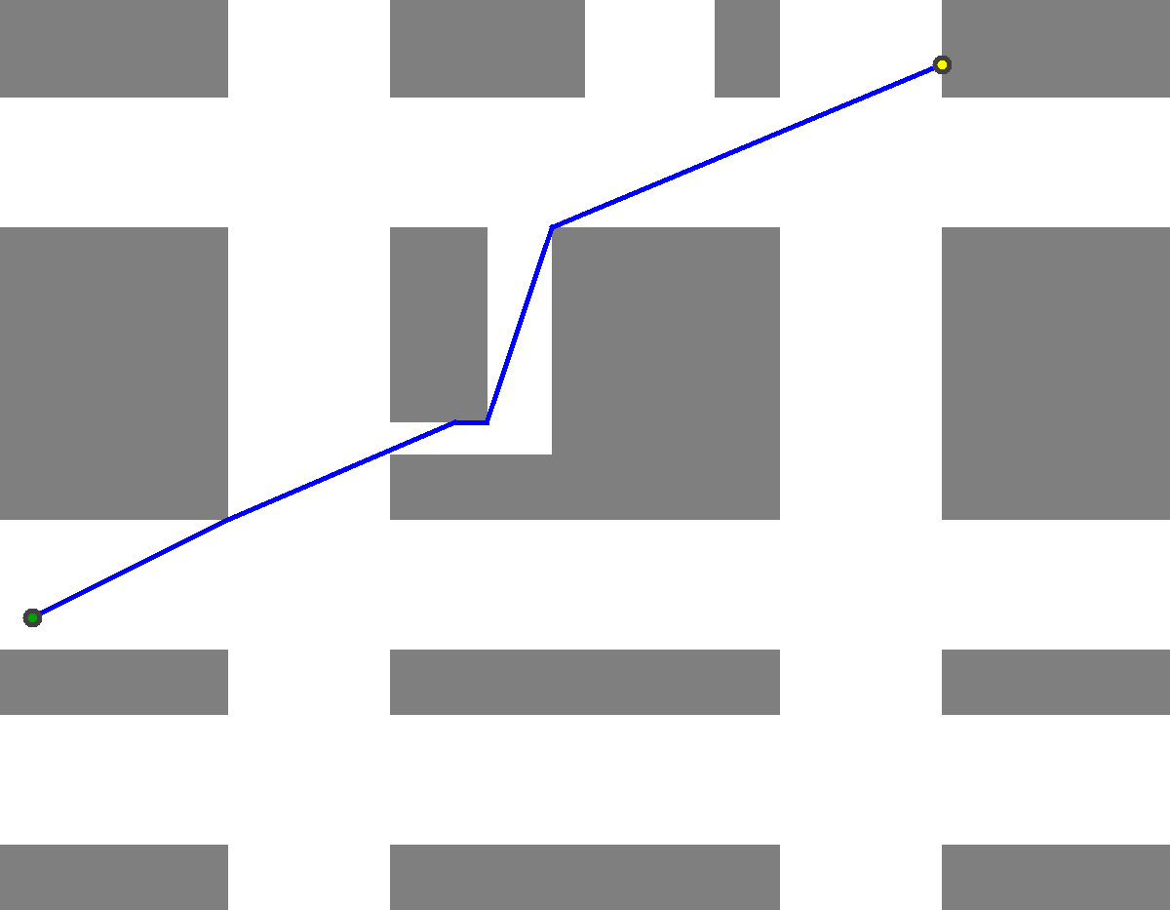
Theta* is not optimal!

Slide 107
Any-Angle Pathfinding
Algorithms
Visibility
Graphs
Theta*

Slide 108
Visibility Graph
Algorithm
Running A* on Visibility Graphs

Slide 109
Two Steps
1) Build Visibility Graph
2) Run A* on it

Slide 110
Visibility Graph
s
t

Slide 111
Visibility Graph
s
t

Slide 112
Outer Corners of Walls: YES
s
t

Slide 113
Start and End Vertex: YES
s
t

Slide 114
Sides of Walls: NO
s
t

Slide 115
Inner Corners of Walls: NO
s
t

Slide 116
Connect all pairs of nodes with
Line-of-Sight to each other.
s
t

Slide 117
The length of each line is its weight.
s
t

Slide 118
Visibility Graph
Algorithm
Demo
VGraph
VisibilityGraph_LostTemple

Slide 119
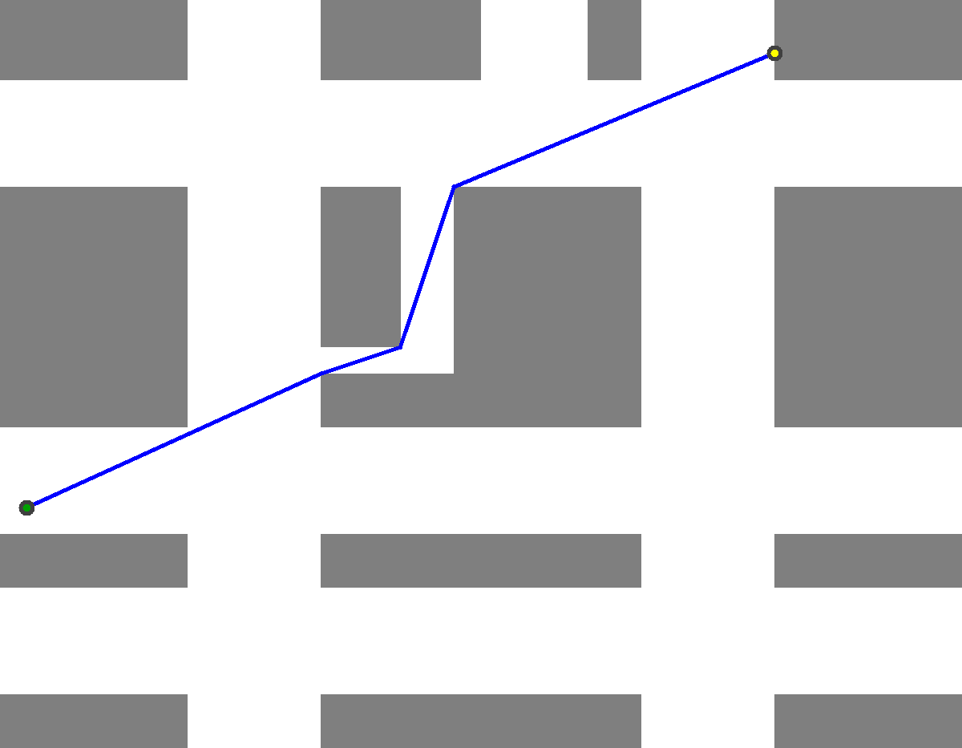
Visibility Graphs are Optimal

Slide 120
Other Algorithms
Post-Smoothing:
Not a pathfinding algorithm, but an extra
post-processing step to “smoothen out” jagged paths.
Lazy Theta*:
If you find Theta* too slow due to the many Line-of-Sight checks,
Lazy Theta* runs faster, but gives slightly longer path lengths.

Slide 121
Other Algorithms
Jump Point Search:
A very fast variation of A* for uniform grids. If speed is top priority, use this with post-smoothing.

Slide 122
Observations

Slide 123

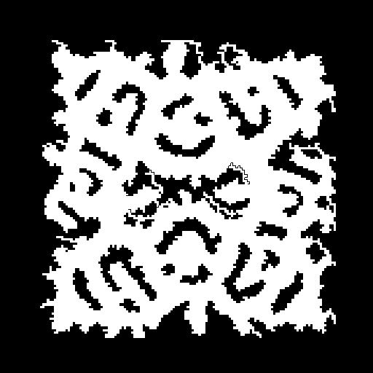
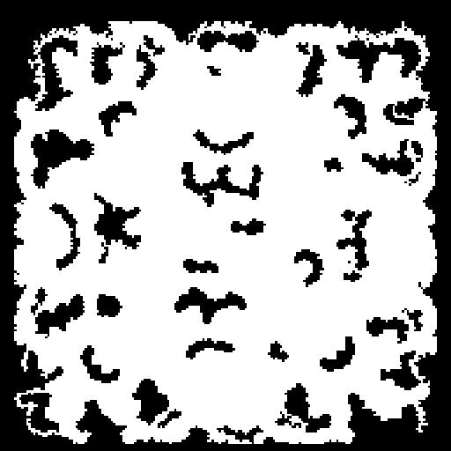


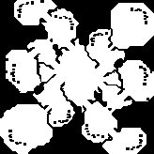
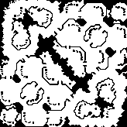


Slide 124
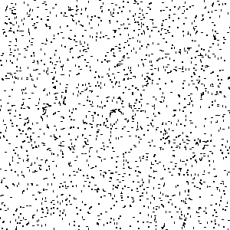
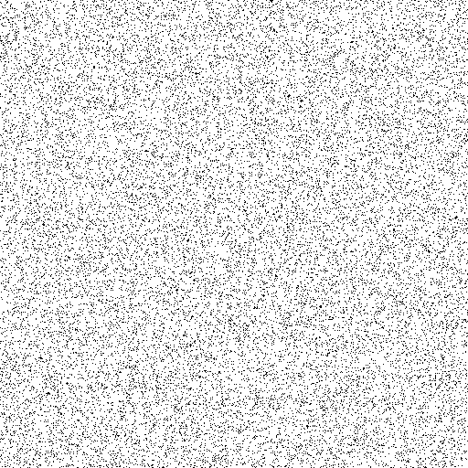
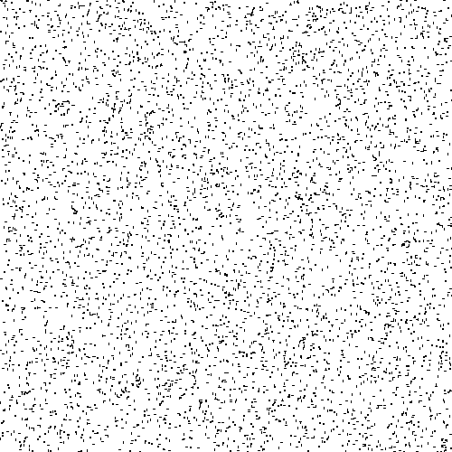
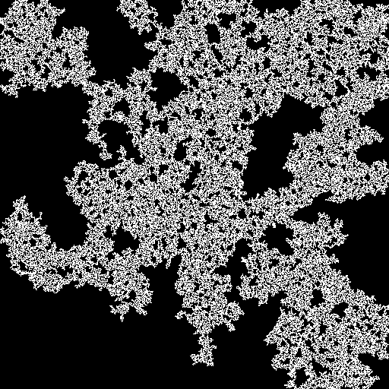
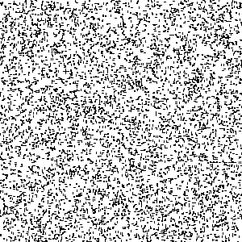

Slide 125

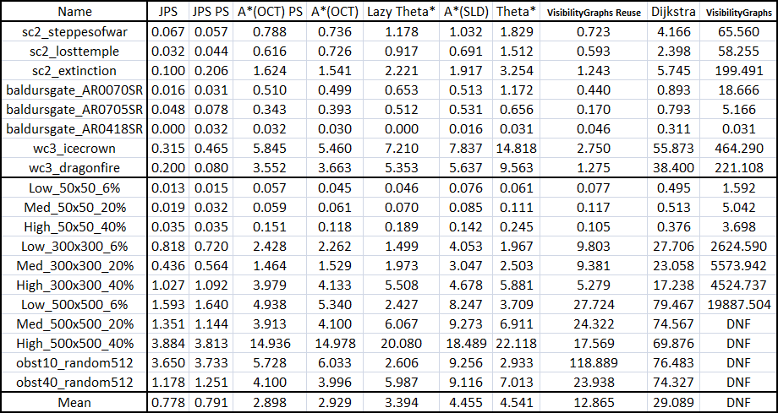
Running Time (ms)

Slide 126

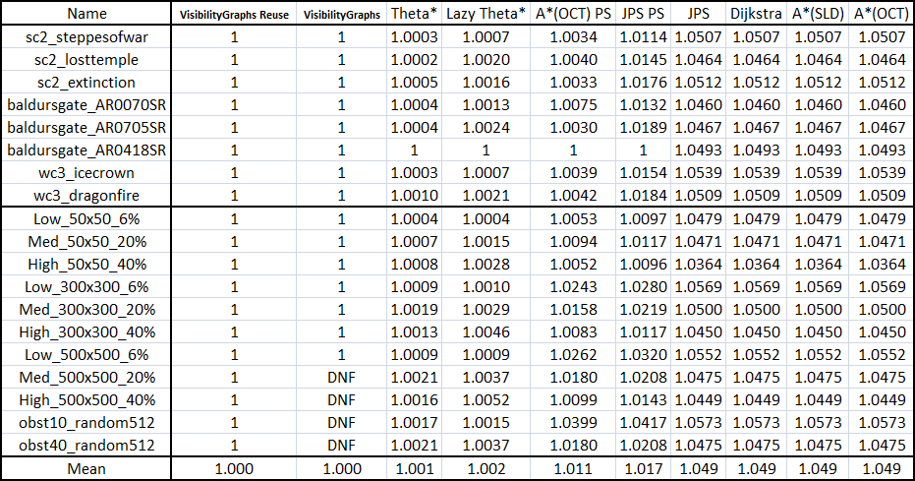
Path Lengths (ratio to optimal)

Slide 127
Running Time
Comparison

Slide 128
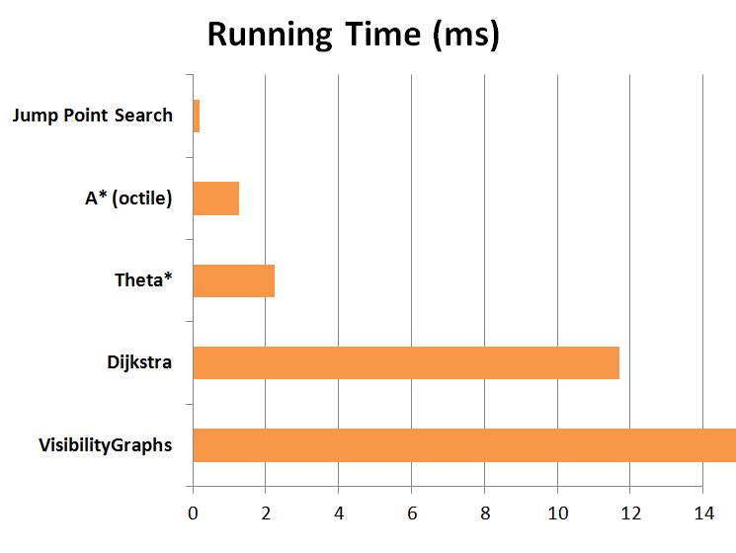

Slide 129
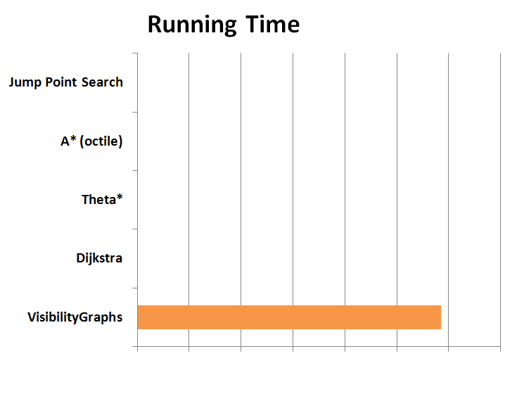

Slide 130
Path Length
Comparison

Slide 131
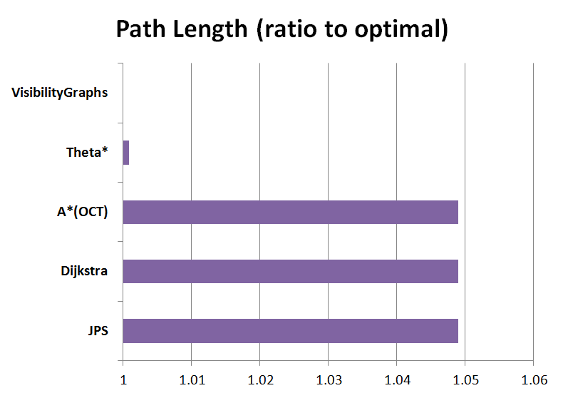

Slide 132
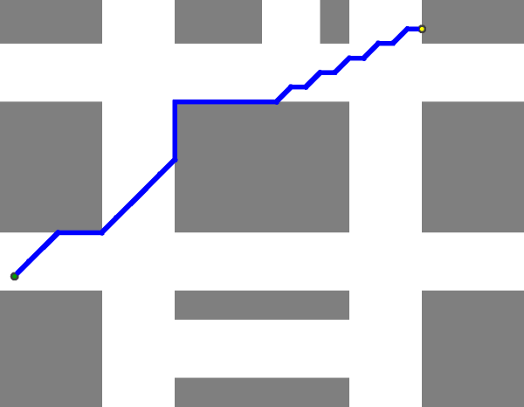
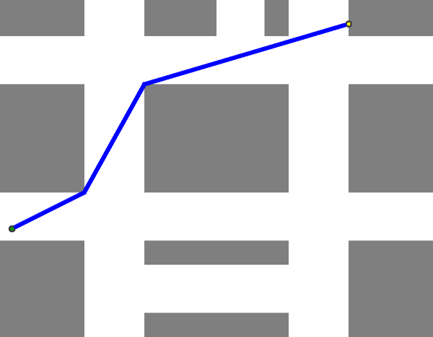
A*,
Dijkstra,
Jump Point Search
Theta*,
VisibilityGraphs

Slide 134
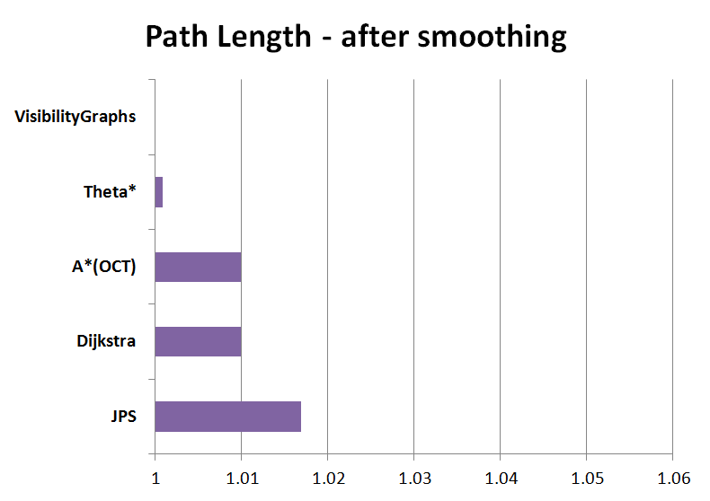

Slide 135
Observations
Don’t do pathfinding without a heuristic!
It makes a lot of difference in running time!

Slide 136
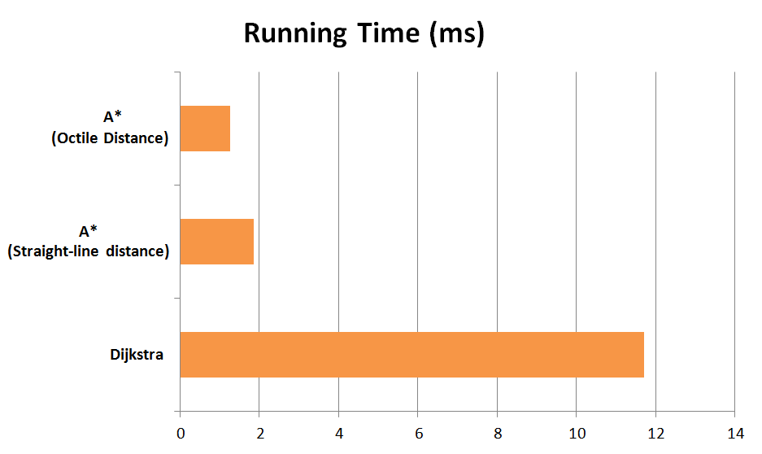

Slide 137
A*
Search Tree
Dijkstra
Search Tree

Slide 138
A* with Octile Heuristic

Slide 139
Conclusion
Theta*:
Runs fast, not optimal
But very close to optimal
Visibility Graphs:
Optimal, but runs very slowly on large maps
A* (8-directional):
With the right heuristic, can run very fast.
But paths are low-quality, even after smoothing

Slide 140
General tips for Pathfinding in Games
The algorithm is often some variant of A*, specific to the game. First find out what is important to your game.
Preallocate all memory.
Have a debugging view to observe how your pathfinding algorithm works.

Slide 141
General tips for Pathfinding in Games
The algorithm is often some variant of A*, specific to the game. First find out what is important to your game.
Preallocate all memory.
Have a debugging view to observe how your pathfinding algorithm works.

Slide 142
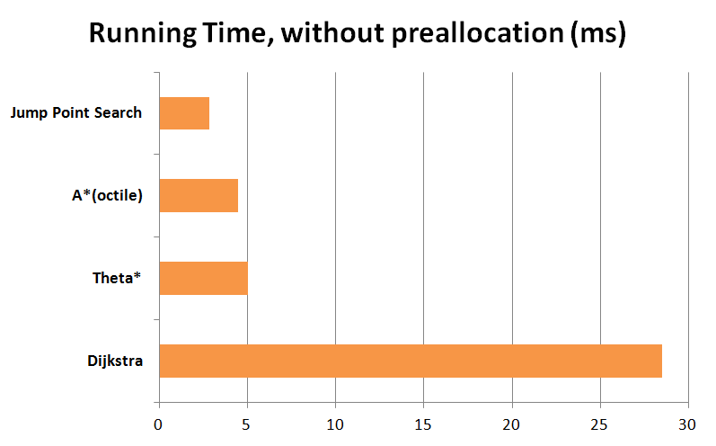
General tips for Pathfinding in Games

Slide 143
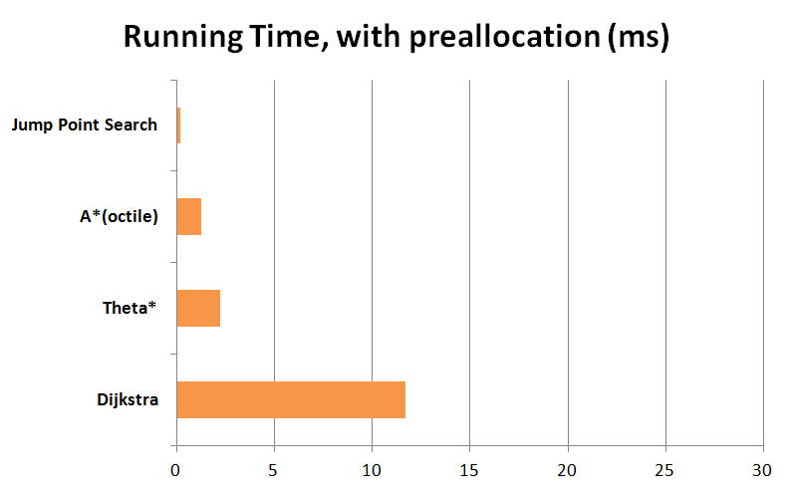
General tips for Pathfinding in Games

Slide 144
General tips for Pathfinding in Games
The algorithm is often some variant of A*, specific to the game. First find out what is important to your game.
Preallocate all memory.
Have a debugging view to observe how your pathfinding algorithm works.

Slide 145
General tips for Pathfinding in Games
The algorithm is often some variant of A*, specific to the game. First find out what is important to your game.
Preallocate all memory.
Have a debugging view to observe how your pathfinding algorithm works.

Slide 146
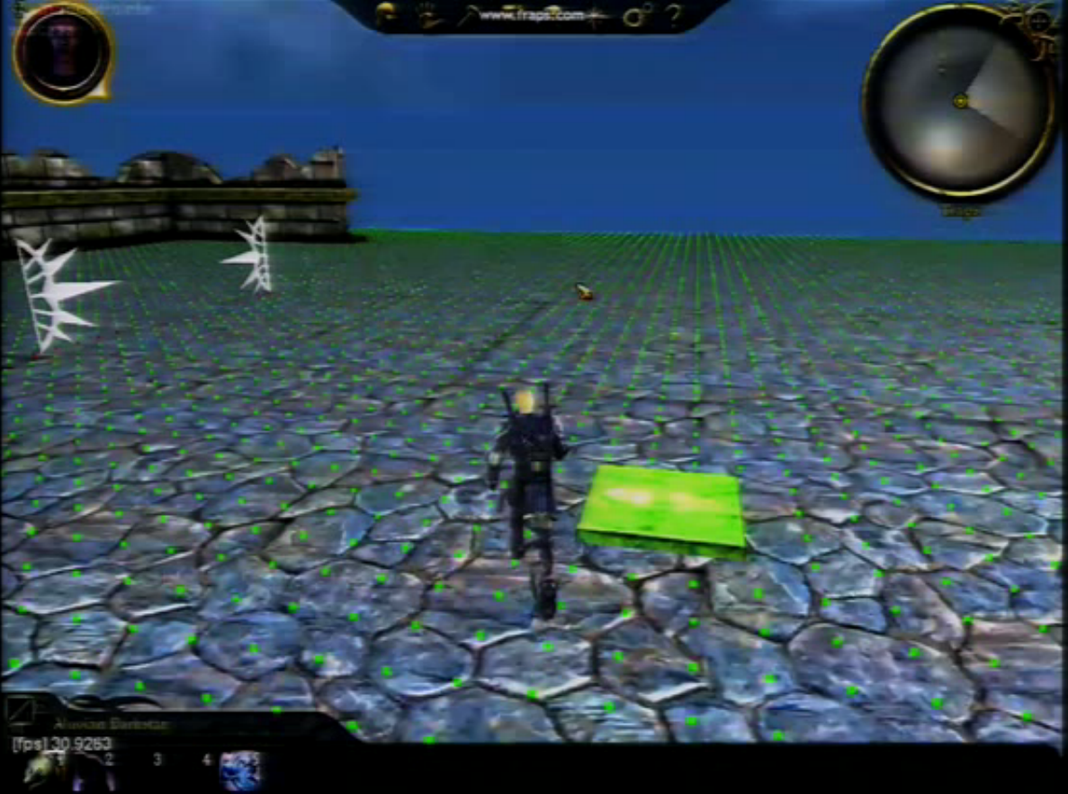

Slide 147
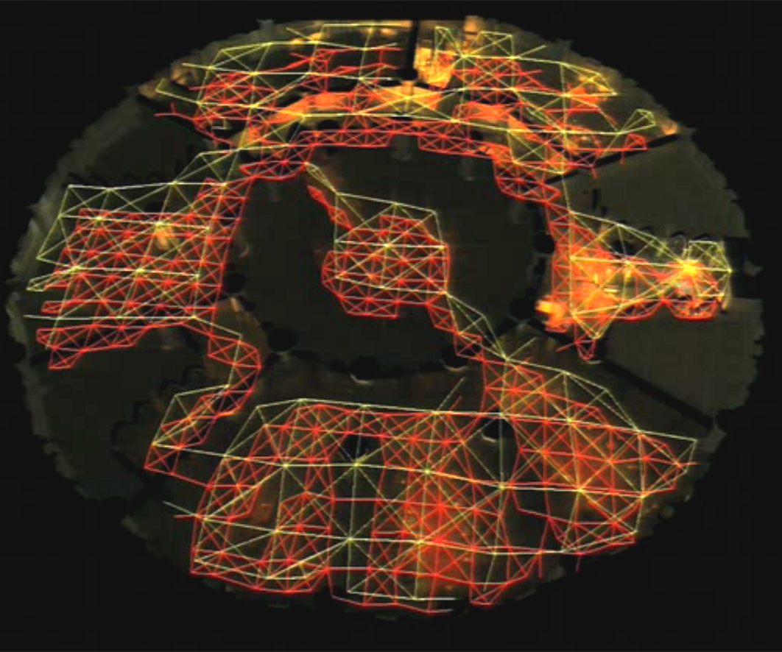

Slide 148
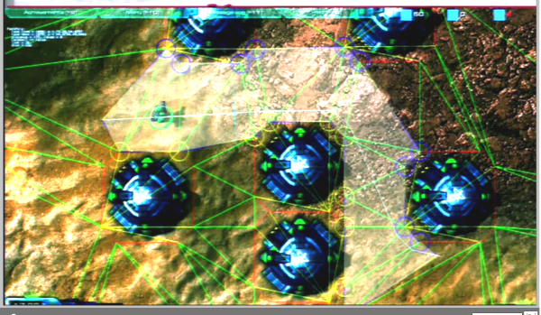

Slide 149
General tips for Pathfinding in Games
The algorithm is often some variant of A*, specific to the game. First find out what is important to your game.
Preallocate all memory.
Have a debugging view to observe how your pathfinding algorithm works.

Slide 150
What I do:
Making a detailed comparison of the various algorithms regarding their utility when making games
Developing a variant of Theta* which finds much better paths than the original
Making animated visualisations for all the algorithms
And making games ☺

Slide 151
Implementations on Github:
github.com/Ohohcakester/Any-Angle-Pathfinding

Slide 152
Advancements in
Any-Angle path planning
2005: Field D* (Ferguson, Stentz)
2007: Theta* (Daniel, Nash, Koenig)
2009: Accelerated A* (Sislak, Volf, Pechoucek)
2011: Block A* (Yap, Burch, Holte, Schaeffer)
2013: Anya (Daniel, Alban)

Slide 153
Acknowledgements
A significant number of the benchmark maps used for testing are taken from movingai.com.
Daniel, K.; Nash, A.; Koenig, S.; and Felner, A. (2010). Theta*: Any-angle path planning on grids. JAIR 39:533–579.
James, A. (2011). AI Navigation: It's Not a Solved Problem... Yet!. In GDC AI Summit 2011.
Daniel, H.; Alban, G. (2011). Online Graph Pruning for Pathfinding on Grid Maps. In AAAI.
Alex, J. (2013, July 16). Lazy Theta*: Faster Any-Angle Path Planning. Retrieved July 2, 2015, from http://aigamedev.com/open/tutorial/lazy-theta-star/
Sturtevant, N. (n.d.). A* Tie Breaking. Retrieved July 2, 2015, from http://movingai.com/astar.html

Slide 154
Let’s end with a little demo of Theta* in action

Slide 155
Questions?

Slide 156
Questions?
Preallocating Memory?
Turning time?
Character size?
Weighted maps?
Avoiding other moving characters?
What algorithms do games use?
Navmeshes or Grids?
What are the factors I should consider?

Slide 157
Questions?
Other Demos:
Jump Point Search
Post-Smoothing
Lazy Theta*

